Slide 1

Amazon Stock Price Prediction
Tejesh Varma Maddana – 811286623
Sushma Palancha - 811297470

Slide 2
1. Introduction 2. Problem Statement 3. Overview of Dataset 4. Data Preparation & Exploration 5. Modelling Approach 6. Performance Evaluation Metrics 7. Visualizations 8. Conclusion 9. Recommendation 10. Thanks
Table of Contents :

Slide 3

Introduction
Project Objective:
Predicting Amazon's stock prices using various machine learning models, including Linear Regression, Support Vector Regression (SVR), and Long Short-Term Memory (LSTM) with Attention.
Importance of Stock Price Prediction:
For Investors: Helps in making informed decisions, optimizing investment strategies, and maximizing returns.
For Businesses: Aids in financial planning, risk management, and strategic decision-making.

Slide 4

Problem Statement
Amazon, a pioneer in cloud computing and e-commerce worldwide, wants to improve its financial forecasting by correctly predicting the price of its stock. In-order to do this, Amazon has hired a financial consulting firm to determine and examine the key variables influencing its stock price. In-light of the stock market's intricacy and volatility, the organization hopes to:
Identify the critical factors that have a major influence on the Amazon stock price prediction.
Evaluate these variables' ability to predict daily closing prices and the direction of stock movement.
Comprehending these variables will facilitate Amazon's ability to make well-informed investment choices, enhance trading tactics, and proficiently handle hazards within the fiercely competitive financial industry.

Slide 5
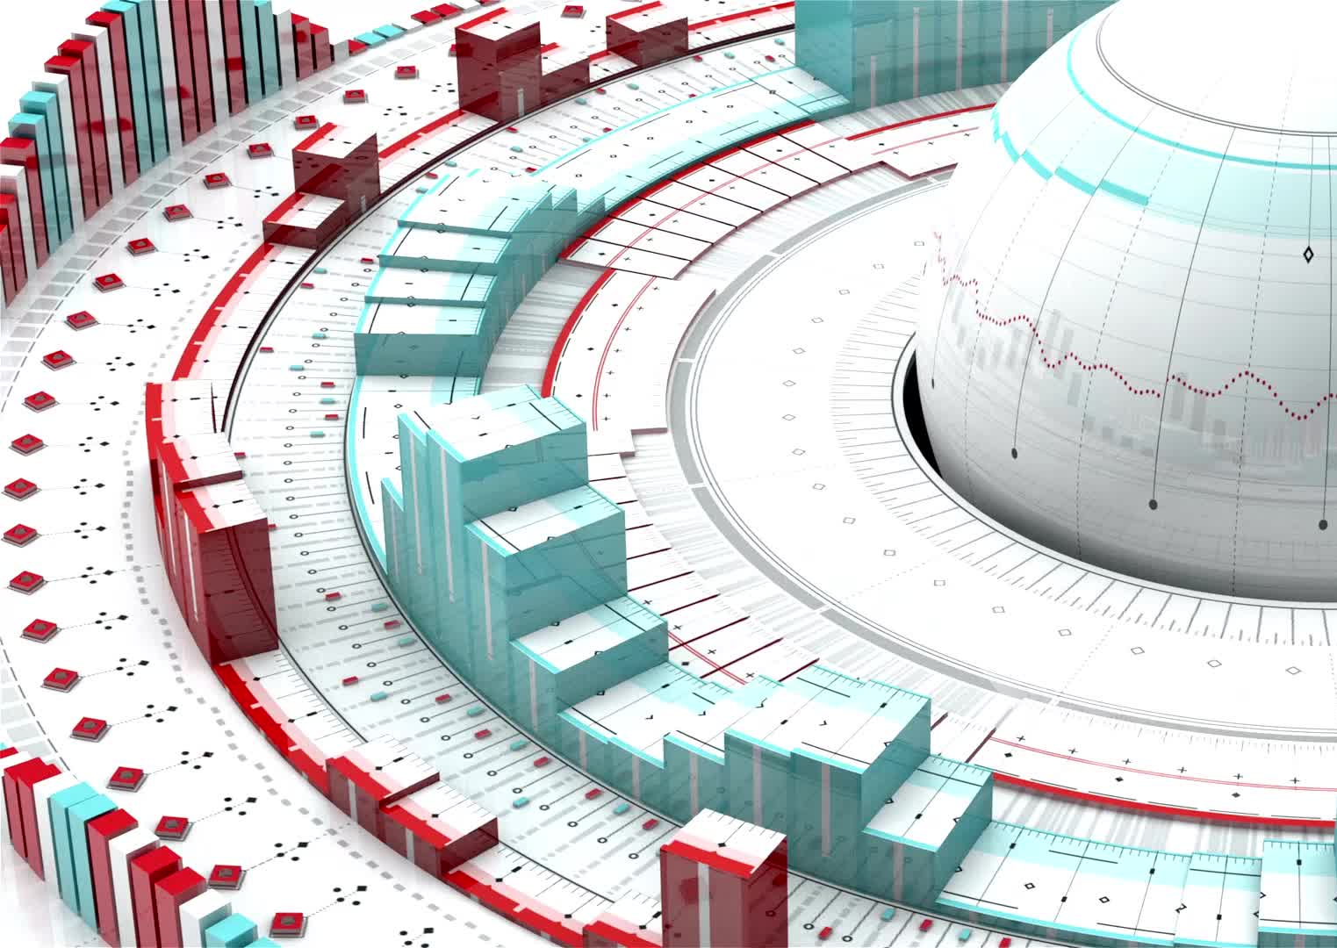
Overview of Dataset
The data set contains information regarding the various factors influencing the price of Stock.
There are a total of 36 columns/attributes like Date, Open, High, Low, Close, Volume e.t.c.,
There are a total of 3552 entries in each column.
No missing values or imbalanced data.

Slide 6
Data Preparation and Exploration
Data Normalisation: - Features were normalised for consistent scale using `StandardScaler}. Feature engineering produced new features such as return, which is the percentage change in closing price.
- Simple Moving Averages (20, 50). - Target: A predicted closing price that has been shifted. Visualisations:- Trends: To see general trends, stock prices were plotted across time.
Feature Scaling: Applied standard scaler to all numeric variables:
Seasonal Patterns: To determine seasonal trends, moving averages were utilised.
Correlations: To comprehend linkages, feature correlations were analysed. Using moving averages, the example visuals show the short-term (20-day) and long-term (50-day) trends in stock prices.
Test and train data
We have divided 80% of data as train and 20% data as test data
Transformed data to have a mean of 0 and standard deviation of 1.
Applied scaler to all variables except:
Yes or no variables, Dummy variables.

Slide 7

Modelling Approach
Linear Regression
Long Short-Term Memory (LSTM) with Attention Mechanism
Support Vector Regression (SVR)

Slide 8
Modelling Approach
1. Linear Regression:
- Used features like Open, High, Low, Close, Volume, and technical indicators.
- Trained using `LinearRegression` from scikit-learn.
- Evaluated with R², MAE, and RMSE metrics.
2. Support Vector Regression (SVR):
- Performed hyperparameter tuning using `RandomizedSearchCV`.
- Used `SVR` with the best parameters for prediction.
- Evaluated with R², MAE, RMSE, and price movement accuracy.
3. Long Short-Term Memory (LSTM) with Attention:
- Prepared data for LSTM by creating sequences.
- Defined an enhanced LSTM model with an attention mechanism.
- Trained using `RandomizedSearchCV` for hyperparameter tuning.
- Evaluated with R², MAE, RMSE, and price movement accuracy.

Slide 9
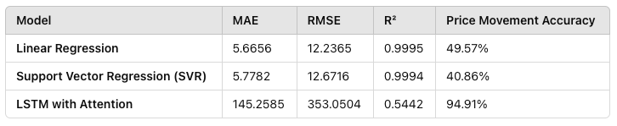
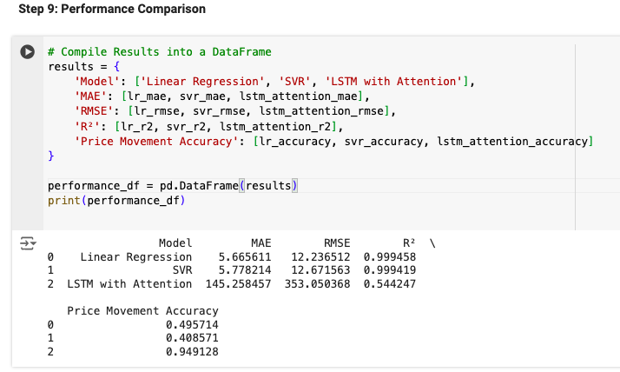
Performance Evaluation Metrics
Linear Regression and SVR performed exceptionally well in terms of R², MAE, and RMSE.
LSTM with Attention showed high accuracy in predicting the direction of stock price movement but had higher error metrics in price prediction.

Slide 10
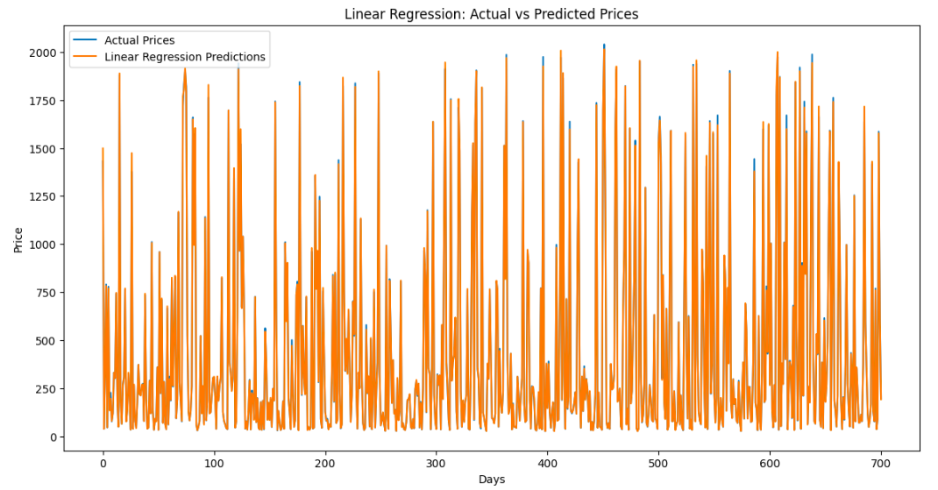
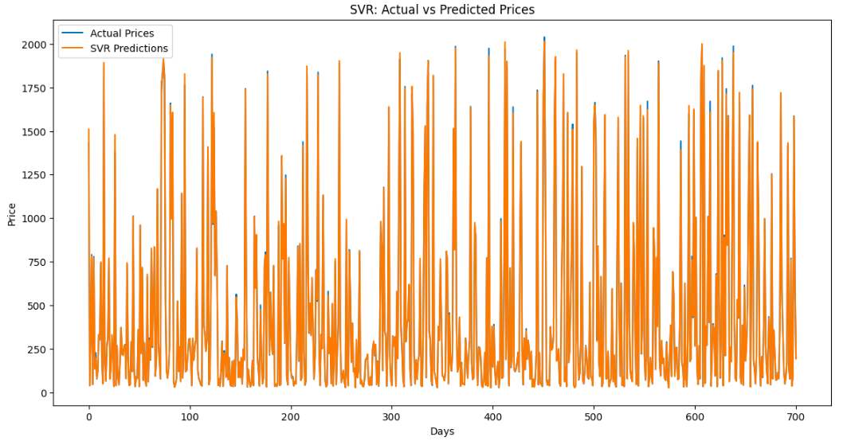
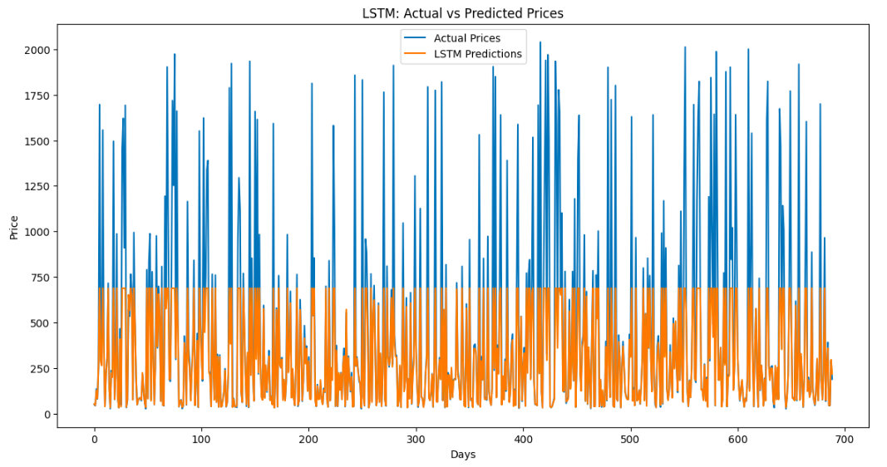
Visualization of Model Performance on LR, SVR & LSTM

Slide 11
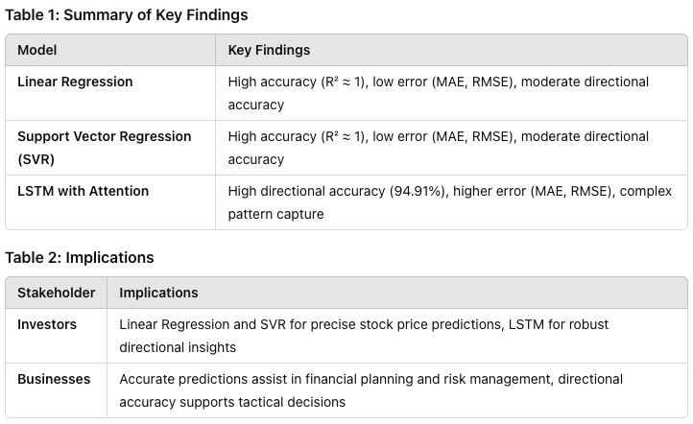
Conclusion :

Slide 12
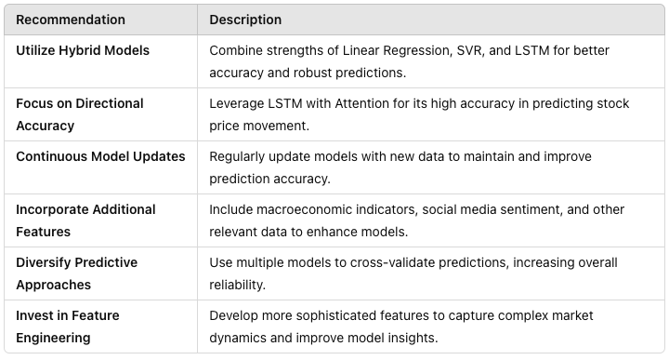
Recommendation

Slide 13
THANK YOU

